Slide 1

SPECIAL OLYMPICS NORTH AMERICA
Flag Football Coaches Training
Notes:
Good afternoon everyone and welcome to the SONA Flag Football coaches training .
The intent of this training is to provide coaches with the necessary building blocks to becoming a flag football coach for Special Olympics
NEXT SLIDE

Slide 2

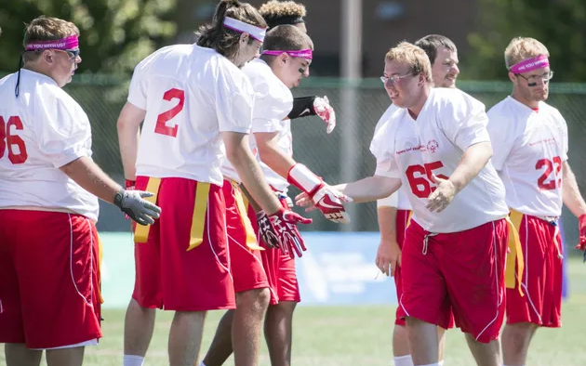
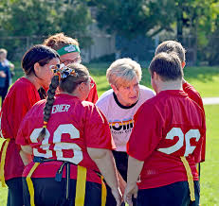
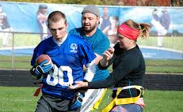
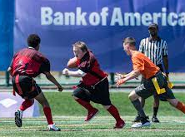
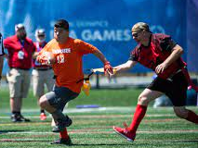
OUR MOTIVATION
Notes:
Why are we here!!!
Most importantly we are here for the athletes – that needs to stay at the forefront – how best can we collectively provide the best possible experience for the athletes who deserve it the most!
NEXT SLIDE

Slide 3

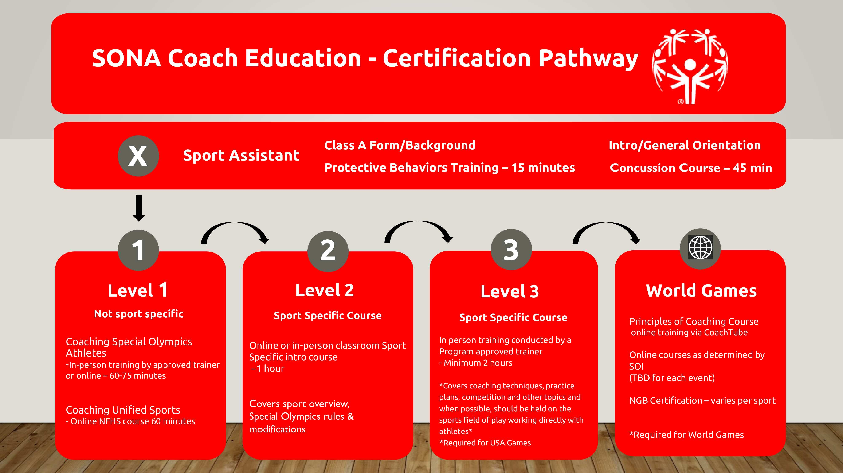
Notes:
Quick reminder that this training fulfills the Level 2 certification for SONA.
*Individual programs may have different pathways and names for certification.*

Slide 4


Administrative Reminders
Yay! Paperwork! (Every coach's favorite part)
Check with your program directors for information on….
Medical info and deadlines
Registration deadlines for competitions
State rules adaptations
Notes:
Before we jump into the sport……Remind coaches that being a coach means paperwork and admin work
You can be a great flag football coach but if you forget to register your team in the tournament you aren’t playing. ☺

Slide 5
Agenda
Why Flag Football
The Game
Equipment and Uniforms
The Field
Scoring
Offense
Running
Passing & Receiving
Defense
Rushing
Flag Pulling
Unified Sports
Penalties
Resources
Notes:
Lots to talk about

Slide 6

POLL TIME
How much do you know!?
Notes:
Either online or in person this is a good chance to get a good idea of everybody’s current knowledge about flag football.

Slide 7
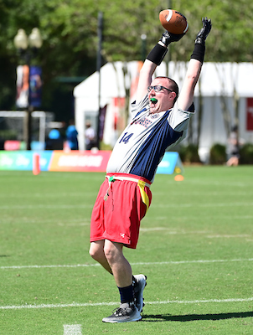
Why Flag Football – Sport Selection
Regionally popular sport
Small Roster size
Differentiation of skills
Inexpensive to start
Segmented play
Touchdown celebrations!!!! ☺
Notes:
Sport selection for our athletes is a key component for our Special Olympics coaches
Regionally popular sport – most popular sport in US (viewership)
Small Roster size (easier to make even teams)
Differentiation of skills (athletes don’t have to be good at everything to have an impact)
Inexpensive to start
Segmented play (Each play is separate so easier for coaches to include everybody)
Touchdown celebrations!!!! ☺
Throughout the training…. the trainer, time permitting, should use their own experiences and knowledge to give best practices for coaches.
Can also mention that individual skills competition is an option also with several states implementing competitions.

Slide 8
RULES, RULES, RULES
Notes:
Rules time

Slide 9

Rule Book
Rules established 2010
State or Provincial Programs may have slight modifications
3rd party events (ie. NIRSA or USA Football) may have slight modifications.
Notes:
Mention which version is current and where to find it.
Note that flag football across the country has a variety of versions and rules.
Can place link to rules in chat
https://media.specialolympics.org/resources/sports-essentials/sport-rules/Sports-Essentials-Flag-Football-Rules-2021-v2.pdf
Dashboard - https://app.smartsheet.com/b/publish?EQBCT=de509754763b47bea739f37d2472f97f

Slide 10
THE GAME

Slide 11
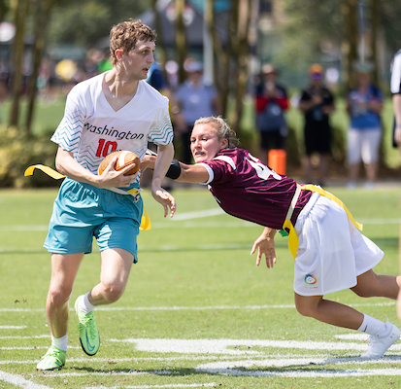
The Basics
Non-Contact, Non-Contact and Non-Contact!
5v5 Traditional and Unified (3 athletes & 2 Partners)
2 Timed Halves
Teams score 6 points by scoring touchdowns followed by an extra point play.
Most points at end of game wins
Notes:
How much time is spent on the basics of football can be modified based on the poll question.
Non contact – over emphasize that this is not tackle football and is called non contact. This doesn’t mean there won’t be inadvertent contact but typically any significant contact in this game = penalty
This non-contact philosophy has to be a major focus for early practices.
Player safety is always paramount
Time spent on this slide might be determined by the audience and their overall knowledge of football.

Slide 12
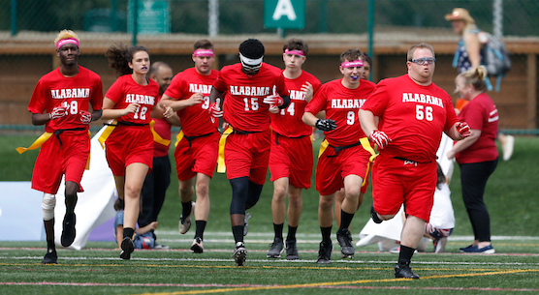
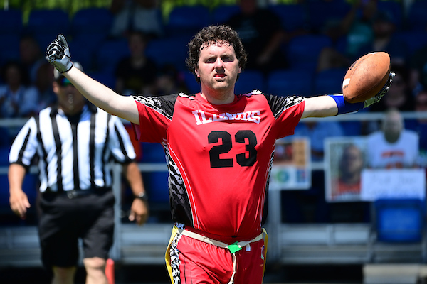
Uniforms - Key Points
No pockets on shorts!
Shirts must be tucked in at waist
No jewelry
Check with league administrators for any local modifications
Notes:
Emphasize no pockets…safety hazard (cannot be zippers or sewed)
Some programs may have slightly different requirements
Short color cannot match flag color

Slide 13
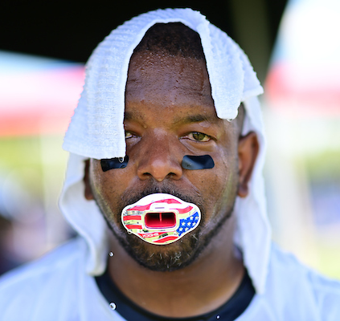
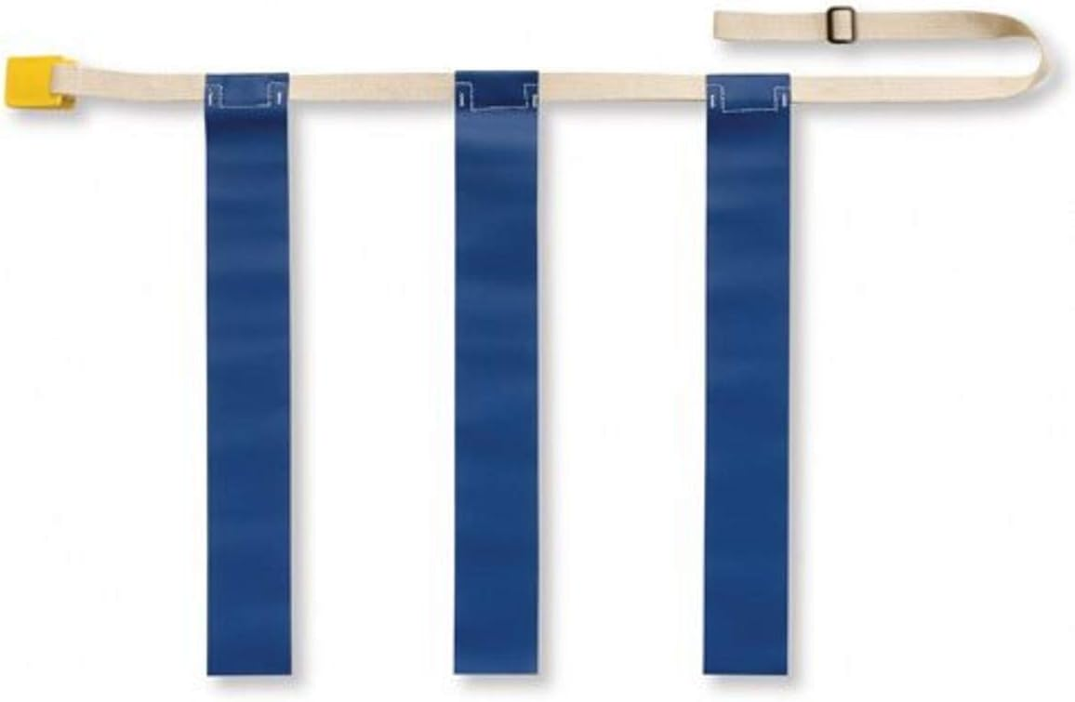
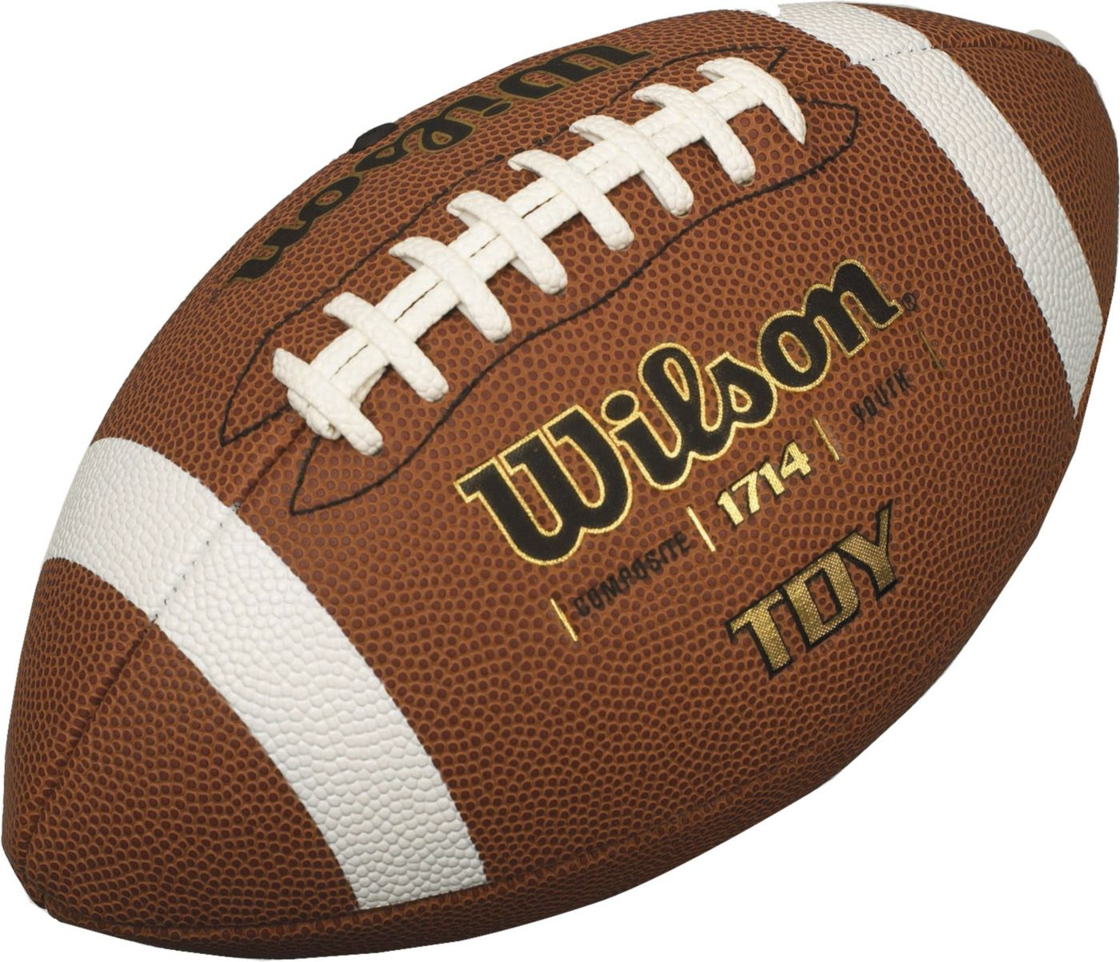
Equipment - Key Points
Ball – Regular or youth size (no junior)
Triple Threat Flag (no detachable)
Protective mouthpiece required
Notes:
Recommend composite over leather footballs.
Discuss the different types of flags (triple threat vs detachable) 3 flags vs 2 and how other leagues use different but for official SONA competition triple threat flags are used.
Can also discuss different sizes of flag beltss when purchasing.
Mouthpiece – make sure athletes have some time to acclimate before competition – different types. Pictured is not only option

Slide 14
THE FIELD
Notes:
How much time is spent on the basics of football can be modified based on the poll question.

Slide 15
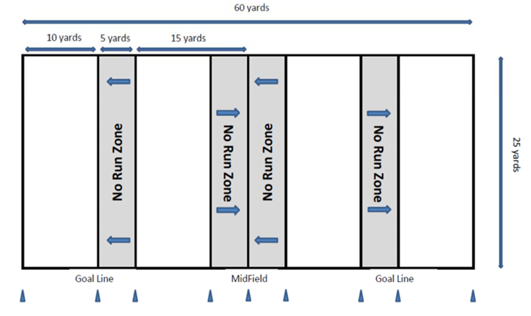
The Field - Dimensions
Notes:
Give scope of field compared to tackle size field (about ¼ size)

Slide 16
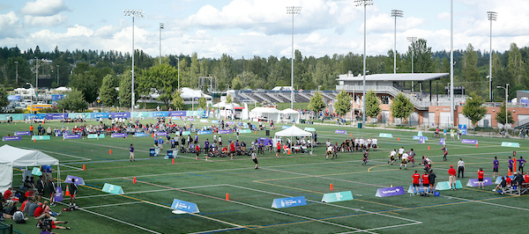
The Field - Example

Slide 17
Possessions
All possessions, except following an interception start at the offensive team’s 5-yard line.
The offense has 4 downs to cross midfield for a first down.
Once the offense crosses mid-field, they have 4 additional downs to score.
If the team fails to cross mid-field or score a touchdown possession of the ball changes and the opposite teams starts at their 5-yard line?
Notes:
NO Kicking or Punting

Slide 18
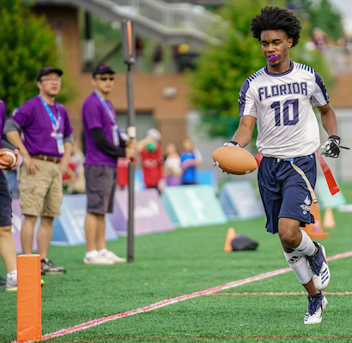
Scoring
Touchdown – 6 points
Extra Point
1 point from the 6-yard line
2 point from the 12-yard line
Safety – 2 points
Notes:
Three ways to score points
Define safety if needed for the group.

Slide 19
OFFENSE
Notes:
This section is discussing the offensive side of the ball and the rules around running and passing.

Slide 20
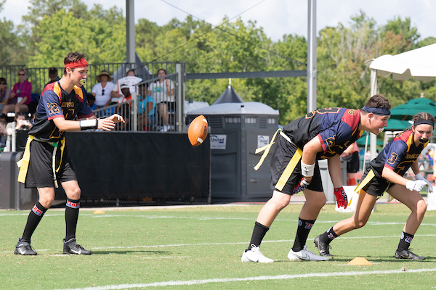
Formations
Line of Scrimmage
The Snap
Motion
Shifts
Notes:
Discuss what happens before the snap.
How can teams line up and how do we start each play.
Proper snaps are an important part of the game and should be practiced.

Slide 21
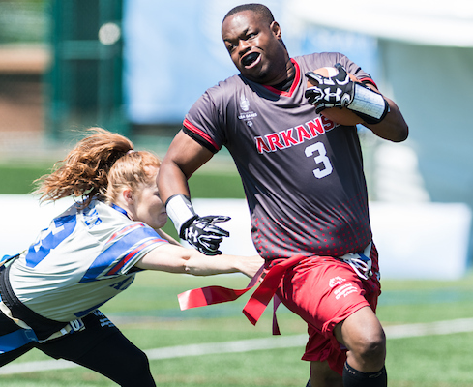
Running – Key Points
Quarterback cannot advance the ball across the line of scrimmage at any point
Handoffs only – no pitches/tosses
No diving, hurdling, stiff arm, or flag guarding
No run zones
Screen Blocking
Notes:
Discuss who is considered QB. (person taking possession of the snap)
Why Qb’s can’t run (philosophy so one player can’t totally dominate game)
Screen blocking – no contact - show allowable techniques
Spend time on no run zones and philosophy of why they exist. May have to go back to field diagram to illustrate
Recent rule change allows spinning now. Remind coaches to check with program to see if this rule has changed for them locally.

Slide 22
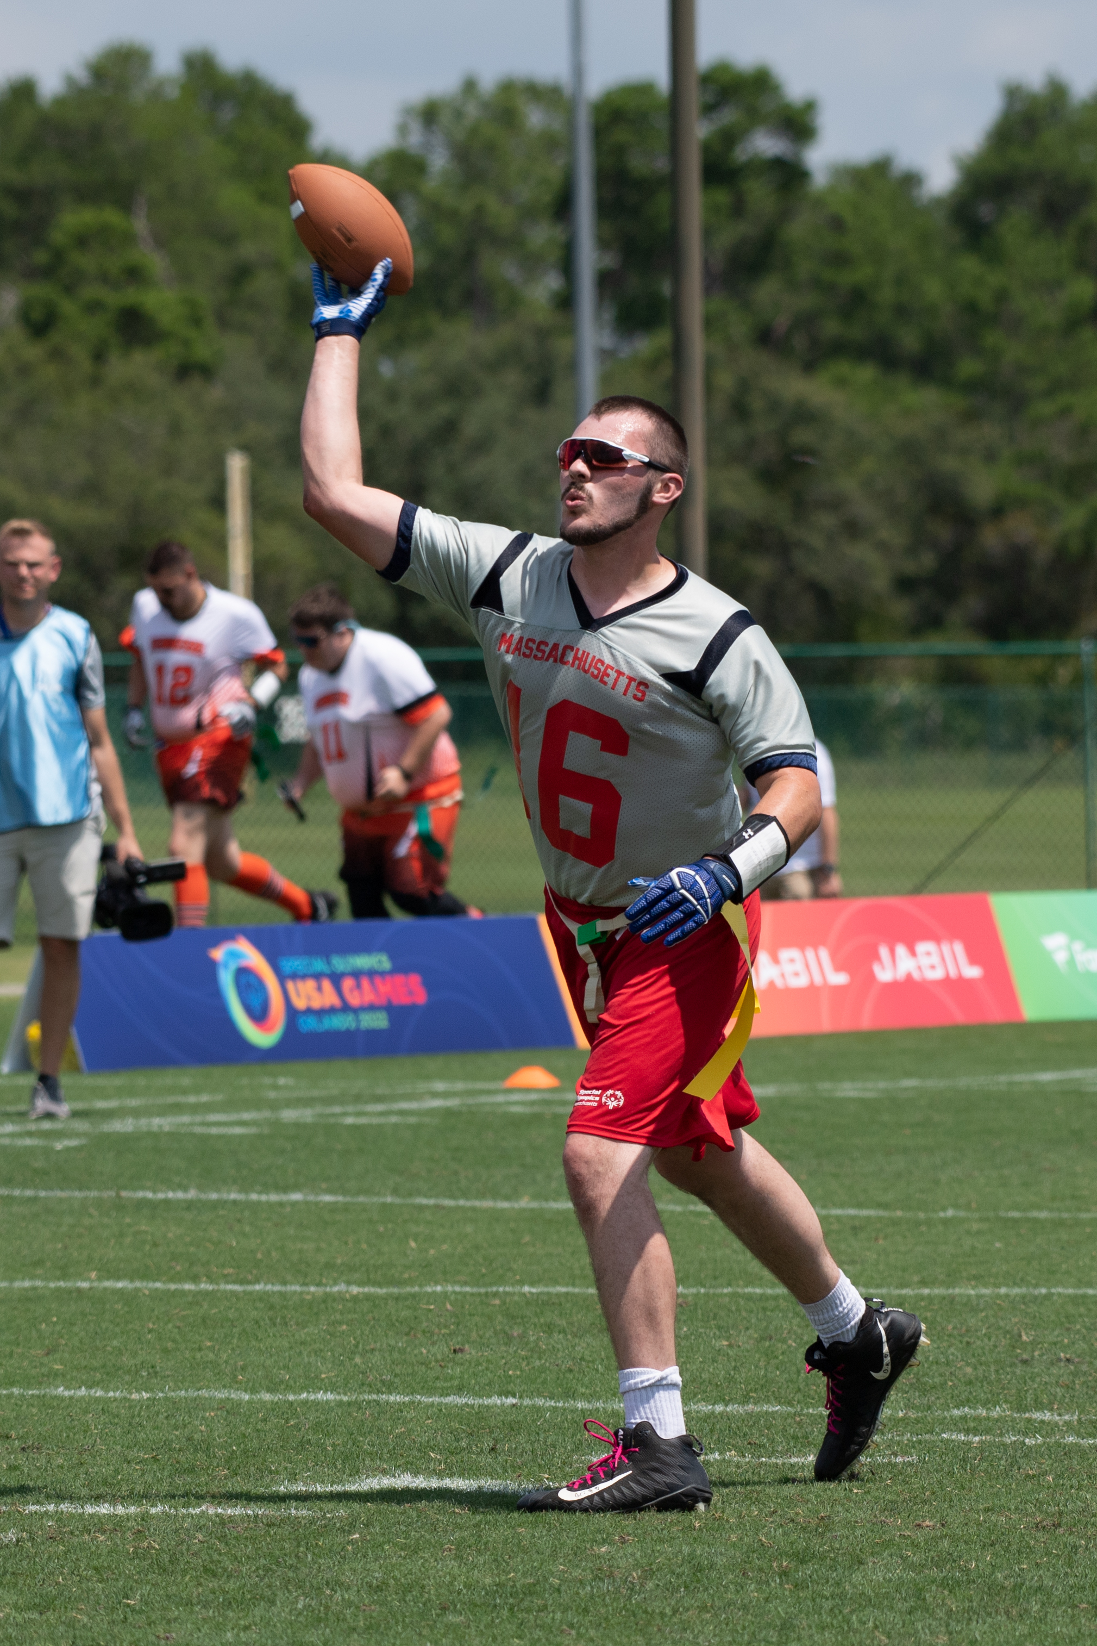
Passing – Key Points
Passes must be forward and across the line of scrimmage
All players eligible to receive passes
Players may dive to catch a pass but not to gain extra yards
Must have 1 foot in bounds when making a catch
Notes:
Can mention the “why”on across the line of scrimmage (because of the rush rule)

Slide 23
DEFENSE
Notes:
This section is discussing the offensive side of the ball and the rules around running and passing.

Slide 24
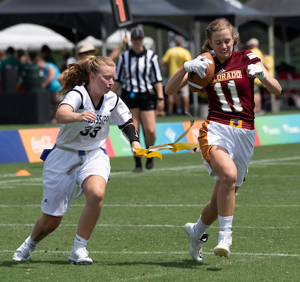
Flag Pulling
A play is over when the defender pulls the ball carriers flag
Ball carrier must have full possession before a legal pull can take place
Flag guarding – Ball carrier cannot obstruct defenders access to flags
Notes:
This is what makes flag so different than tackle. The basis of the game
Spend most of time for this slide on flag guarding and that contact must occur for their to be flag guarding
Additionally, the flag guarding does not have to be intentional
Coaching Best Practice – This is a skill that needs to be focused on in practice. Include drills for this at every practice for the defense.

Slide 25
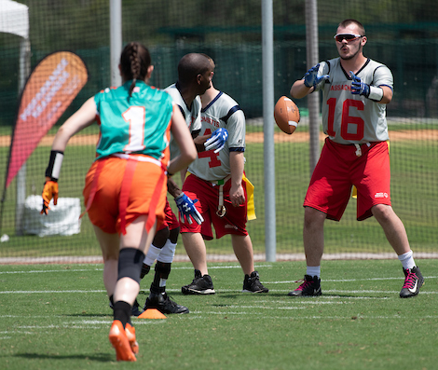
Pass Rush
Rushers must start at least 7 yards from line of scrimmage when ball is snapped
This spot is marked by a cone or special marker designated by officials or volunteers
Players not rushing QB can defend Line of scrimmage.
Once QB hands ball off all players can rush
Notes:
With no contact blocking the 7 yard buffer is a key to the game that gives the QB time to throw.
The pass rusher is a very important defensive position that can impact the game greatly.

Slide 26

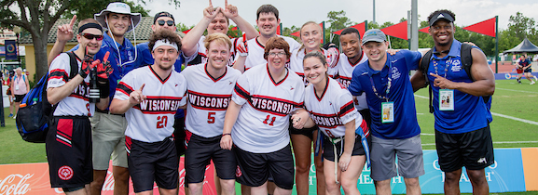
UNIFIED
Notes:
This section is discussing the offensive side of the ball and the rules around running and passing.

Slide 27
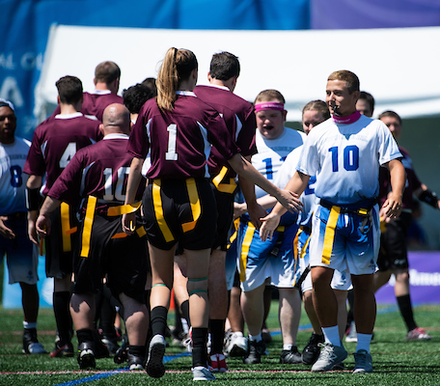
Unified
The line-up shall never exceed three (3) athletes and two (2) partners.
Partners may NOT pass to another partner. (handoffs ok)
All teams are expected to adhere to and perform under the Special Olympics Unified Sports® Principle of Meaningful Involvement.
Notes:
Also can mention that partners CAN guard athletes
Quick discussion of Unified philosophy and how much strategy can come into play for competitive model games.
(ie. what changes with a partner QB vs an athlete QB)

Slide 28
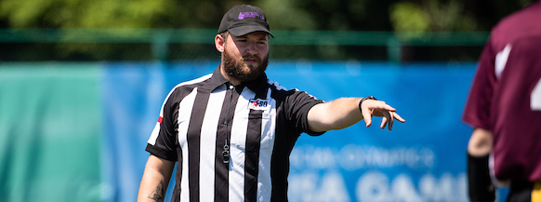
PENALTIES

Slide 29
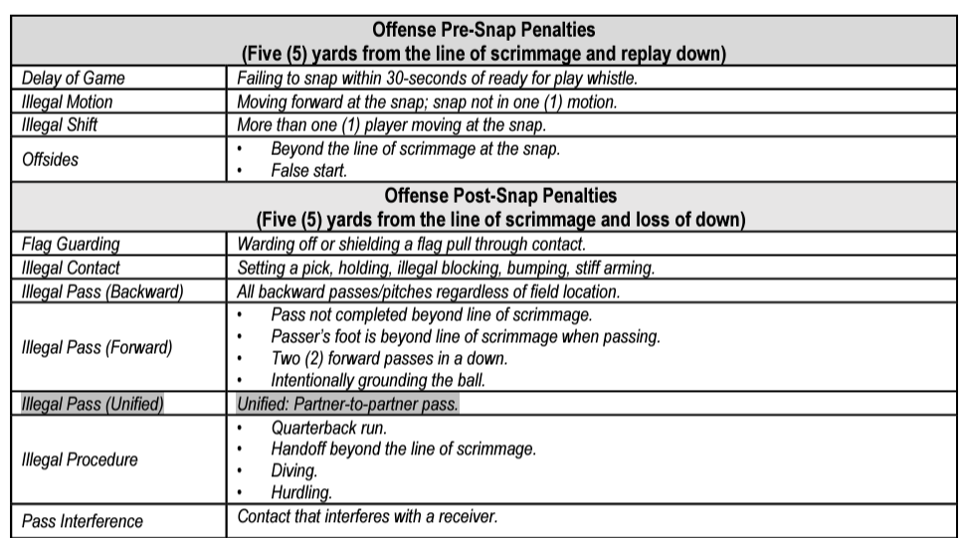
Penalties
Notes:
Key points and penalties
Enforcement is different than NFL or college football – discuss difference
Pass interference/Illegal contact is different than NFL or college football. NO CONTACT once receiver or defender touches ball
Ask if any questions about a rule

Slide 30
RESOURCES
Notes:
This section is discussing the offensive side of the ball and the rules around running and passing.

Slide 31
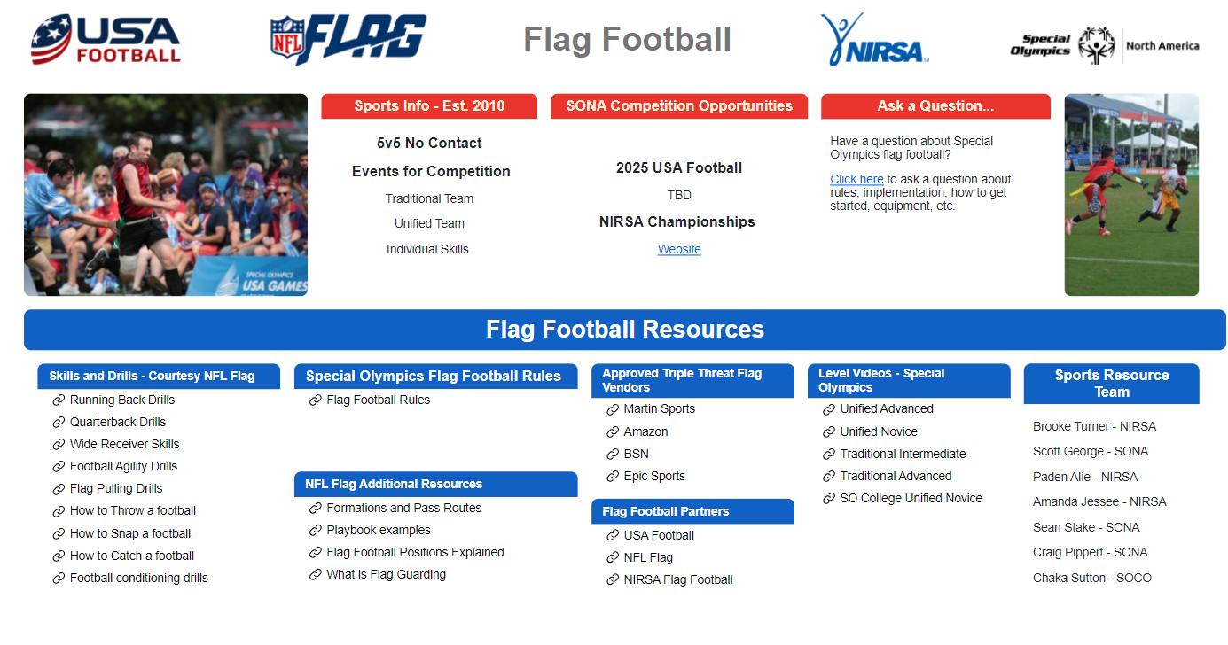
Resources
Notes:
Dashboard – give link
Highlight the drills and videos of special Olympics games
They can also ask questions for the Sport Resource Team
They can also check with the local program or league for additional resources

Slide 32
ADDITIONAL TRAINING
Notes:
This section is discussing the offensive side of the ball and the rules around running and passing.

Slide 33
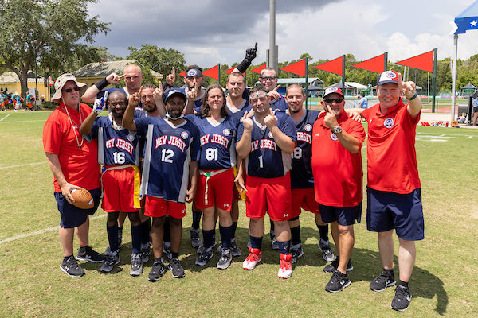
In-person Training
Practice Plans
Team Creation
Teaching the Skills
Competition management
Strategy
Overall best practices
Notes:
This training has been an introduction to the course. To truly take your coaching to the next level it’s important to get out the field with other coaches and athletes and learn how to coach the athletes.

Slide 34
QUESTIONS
Notes:
Ask for questions and thank them for attending

