Slide 1
Family Health Forum
29 June, 2020
The mark “CDC” is owned by the US Dept. of Health and Human Services and is used with permission. Use of this logo is not an endorsement by HHS or CDC of any particular product, service, or enterprise.

Slide 2
Notes:
Crystal Womack - has been an athlete for 14 years; playing golf, bowling, speed skating, athletics, and figure skating. Crystal is a Health Messenger and serves on SOWA's Board of Directors. Crystal is passionate about helping her fellow athletes improve their health, and about improving the way doctors interact with and care for individuals with ID.
Rebecca Partridge - Rebecca is a pediatrician at Virginia Mason in Issaquah. Her medical interests include Down syndrome and emergency medicine. Rebecca is also a parent of a Special Olympics athlete. In her free time she enjoys playing with her two children, reading, baking, and playing the piano.

Slide 3
Agenda
Opening and housekeeping (5 minutes)
Introductions (10 minutes)
Guest presentation (15-20 minutes)
Questions and discussion (20 minutes)
SOWA & Regional Resources
Wrap up (5 minutes)
Notes:
Ask participants to put in the chat where they are from

Slide 4
Objectives
Learn about COVID-19 and impact on ID population
Discuss how to keep ourselves and others safe
Discuss safe return to activity
Learn of Special Olympics Washington and regional resources

Slide 5
Questions & Discussion
Notes:
We are going to administer a quick poll about COVID19 – the questions should pop up on your screen. We will give you a minute or so to answer.

Slide 6
Resources
Family Support Coordinators
Wellness Coordinators
NORTHEAST
Cathy Armacost
cathyarmacost@gmail.com
NORTH CENTRAL
Robyn Weber
rwebersowa@sowa.org
KING COUNTY
Sandra Lum
san4sowa@gmail.com
COLUMBIA RIVER
Brenda Tyrell
brendat@peacenw.org
NORTHEAST
Kami Smith
krsmithsowa@gmail.com
TRI-CITIES
Melissa Brooks
p2p@arcoftricities.com
SOUTHEAST
Tana Abbott
tana56@cableone.net
Notes:
Leah

Slide 7
Resources
Special Olympics Washington
COVID Updates
High Risk Population
Health Programs
Family Support
Fitness at Home
Special Olympics COVID Resources
Getting Ready for your Health Care Visit
Self-Care for Families
COVID e-learning course
Caregiver’s Guide to Oral Health
General COVID Resources
Coronavirus in Plain Language
Face Masks for People with IDD (The Arc)
Groups at Higher Risk (CDC)
Advocacy and Resources (Disability Rights WA)
Autism-specific COVID Resources
Down syndrome-specific COVID Resources
Cerebral Palsy-specific COVID Resources
Diabetes-specific COVID Resources
Notes:
Many resources – this long (hard to read) list is just to give an idea of the many resources available. We will share out the list to registrants and on our website.

Slide 8
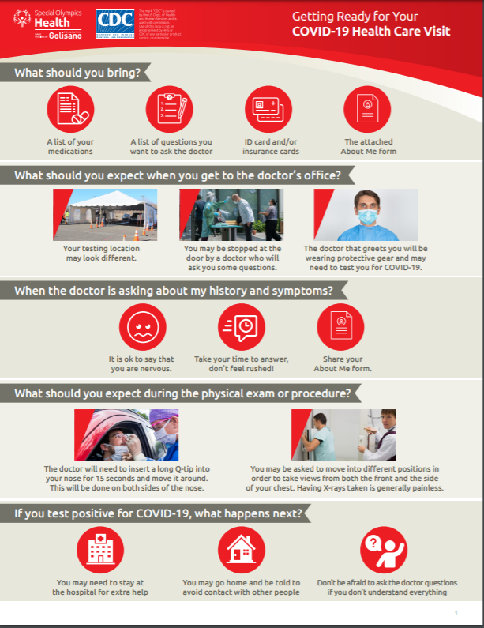
Resources – Health Care Visit
Notes:
Here is one example of the types of resources – We will send the link to this form in the follow up notes from today’s session
https://media.specialolympics.org/resources/covid-19/SOI-About-Me-Form-2.pdf?_ga=2.39520419.100957725.1593460646-415709872.1589506236

Slide 9
Special Olympics Precautions
Notes:
Ask Crystal her input here?

Slide 10
Resources – Fitness at Home
Notes:
Dr. Partridge mentioned how social and physical health is important- We are excited to continue our Weekly Wednesday Workouts at 4pm on Wednesday’s as well as the Virtual Summer Games
Virtual Summer Games Registration: https://forms.gle/hYzpoPz6JGGs1FUf7

Slide 11
Next Forum
July 27th at 6:00pm PST
Notes:
Announce next forum date and share registration link in chat – LAST MONDAY OF EVERY MONTH
Share registration link in chat https://us02web.zoom.us/meeting/register/tZcrdeuppj4sH9DNVtP4Zi7zuYwHTIukgQ_K

Slide 12
Contact: Della Norton / Director of Health Programs / dnorton@sowa.org Leah Shaffner / Initiatives Manager / lshaffner@sowa.org
The mark “CDC” is owned by the US Dept. of Health and Human Services and is used with permission. Use of this logo is not an endorsement by HHS or CDC of any particular product, service, or enterprise.

